Slide 1

Working with Chat Completions Part 1

Slide 2
Steven Magee
“I always assume a strange person that is chatting with me is an undercover police officer.”

Slide 3
Where We Left Off…
from openai import OpenAI
client = OpenAI()
completion = client.chat.completions.create(
model="gpt-4-turbo-preview",
messages=[
{"role": "system", "content": "You are an expert in penguins."},
{"role": "user", "content": "Give me a list of 10 species of penguins in the world. Just give me the list and nothing else."}
]
)
print(completion.choices[0].message.content)
Notes:
from openai import OpenAI
client = OpenAI()
completion = client.chat.completions.create(
model="gpt-4-turbo-preview",
messages=[
{"role": "system", "content": "You are an expert in penguins."},
{"role": "user", "content": "Give me a list of 10 species of penguins in the world. Just give me the list and nothing else."}
]
)
# Before getting just the content
print(completion.choices[0].message)
# After getting just the content of the message
print(completion.choices[0].message.content)

Slide 4
Let’s Go Deeper
Beyond the Simple Chat Completion
Notes:
https://platform.openai.com/docs/guides/text-generation

Slide 5
What Are Our Options?
messages
model
frequency_penalty
logit_bias
logprobs
top_logprobs
max_tokens
n
presence_penalty
response_format
seed
stop
stream
temperature
top_p
tools
tool_choice
user
Notes:
https://platform.openai.com/docs/api-reference/chat/create

Slide 6
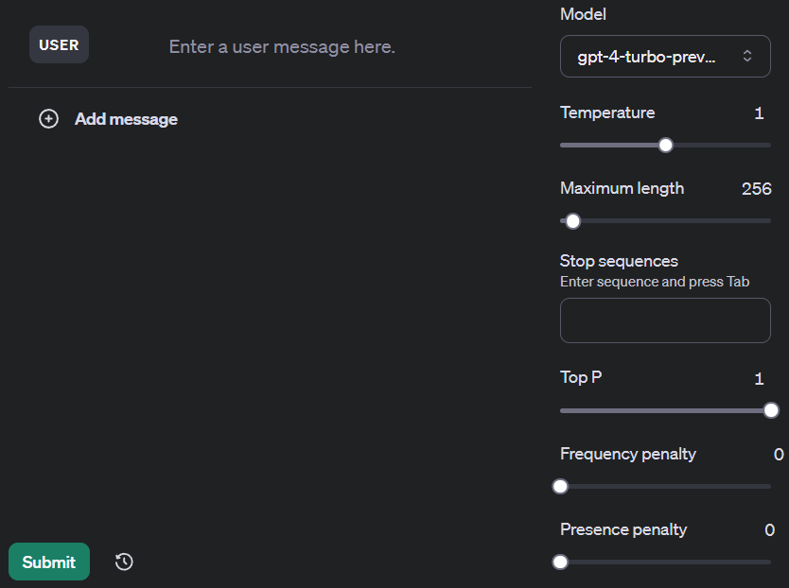
Review Time!
messages
model
temperature
max_tokens
stop
top_p
frequency_penalty
presence_penalty
Notes:
https://platform.openai.com/playground/chat
https://platform.openai.com/docs/api-reference/chat/create

Slide 7
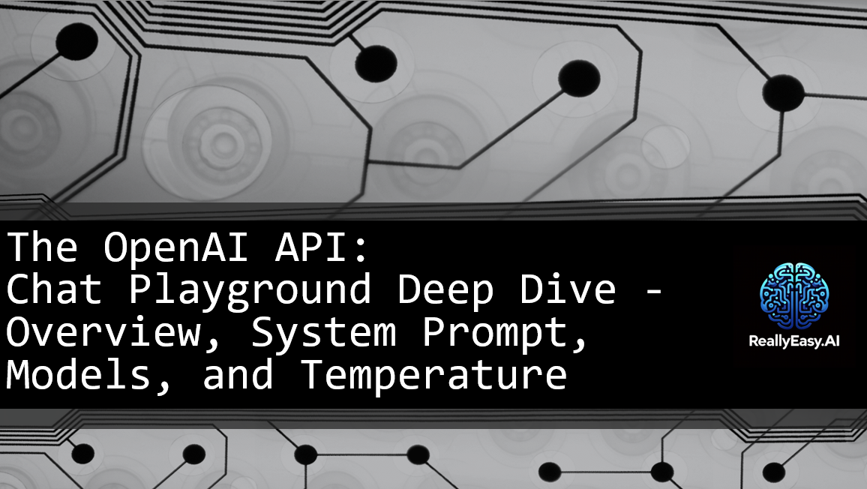
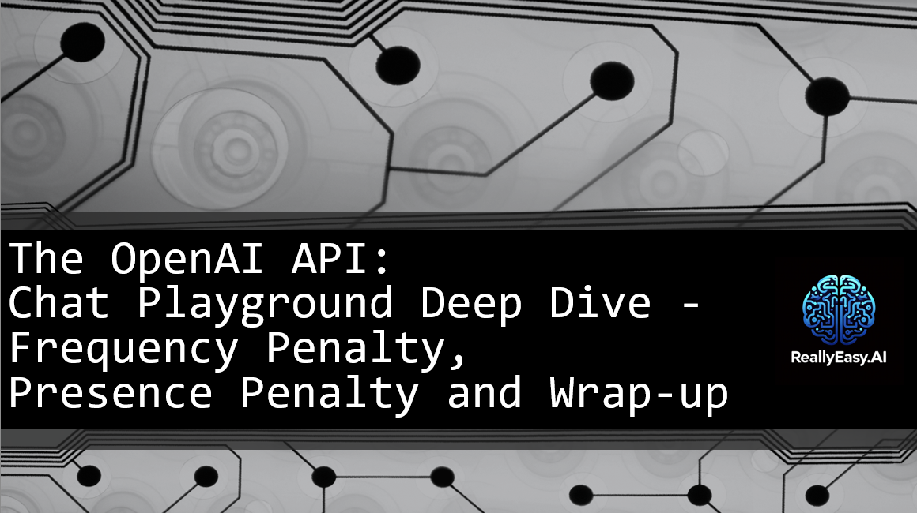

Slide 8
Model and Messages are Required
from openai import OpenAI
client = OpenAI()
completion = client.chat.completions.create(
model="gpt-4-turbo-preview",
messages=[
{"role": "system", "content": "You are an expert in penguins."},
{"role": "user", "content": "Give me a list of 10 species of penguins in the world. Just give me the list and nothing else."}
]
)
print(completion.choices[0].message)

Slide 9
Temperature from 0 to 2
from openai import OpenAI
client = OpenAI()
completion = client.chat.completions.create(
model="gpt-4-turbo-preview",
messages=[
{"role": "system", "content": "You are an expert in penguins."},
{"role": "user", "content": "Give me a list of 10 species of penguins in the world. Just give me the list and nothing else."}
],
temperature=1
)
print(completion.choices[0].message.content)

Slide 10
Max_Tokens (Limited to Context Length)
from openai import OpenAI
client = OpenAI()
completion = client.chat.completions.create(
model="gpt-4-turbo-preview",
messages=[
{"role": "system", "content": "You are an expert in penguins."},
{"role": "user", "content": "Give me a list of 10 species of penguins in the world. Just give me the list and nothing else."}
],
temperature=1,
max_tokens=256,
)
print(completion.choices[0].message.content)

Slide 11
Stop (Words)
from openai import OpenAI
client = OpenAI()
completion = client.chat.completions.create(
model="gpt-4-turbo-preview",
messages=[
{"role": "system", "content": "You are an expert in penguins."},
{"role": "user", "content": "Give me a list of 10 species of penguins in the world. Just give me the list and nothing else."}
],
temperature=1,
max_tokens=256,
stop=None,
)
print(completion.choices[0].message.content)

Slide 12
Top_P
from openai import OpenAI
client = OpenAI()
completion = client.chat.completions.create(
model="gpt-4-turbo-preview",
messages=[
{"role": "system", "content": "You are an expert in penguins."},
{"role": "user", "content": "Give me a list of 10 species of penguins in the world. Just give me the list and nothing else."}
],
temperature=1,
max_tokens=256,
stop=None,
top_p=1,
)
print(completion.choices[0].message.content)

Slide 13
Frequency_Penalty
from openai import OpenAI
client = OpenAI()
completion = client.chat.completions.create(
model="gpt-4-turbo-preview",
messages=[
{"role": "system", "content": "You are an expert in penguins."},
{"role": "user", "content": "Give me a list of 10 species of penguins in the world. Just give me the list and nothing else."}
],
temperature=1,
max_tokens=256,
stop=None,
top_p=1,
frequency_penalty=0,
)
print(completion.choices[0].message.content)

Slide 14
Presence_Penalty
from openai import OpenAI
client = OpenAI()
completion = client.chat.completions.create(
model="gpt-4-turbo-preview",
messages=[
{"role": "system", "content": "You are an expert in penguins."},
{"role": "user", "content": "Give me a list of 10 species of penguins in the world. Just give me the list and nothing else."}
],
temperature=1,
max_tokens=256,
stop=None,
top_p=1,
frequency_penalty=0,
presence_penalty=0,
)
print(completion.choices[0].message.content)

Slide 15


